Slide 1
Community Engagement
Girls Build LA Webinar
January 2018

Slide 2
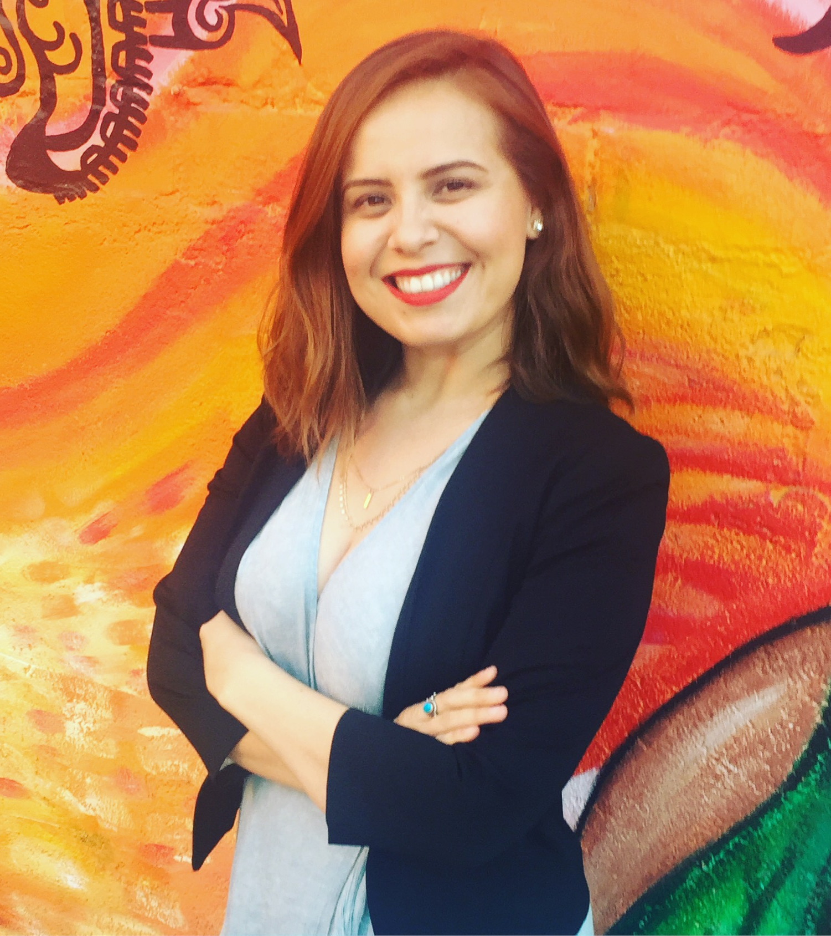
About Me
Hometown: Anaheim, CA
Family: Mexican Brady Bunch
Undergrad: CSULB (go BEACH!)
Graduate: USC
Fun fact: I won “Best Bad Hair Days” in high school
Current role: Community Development Specialist, Microsoft

Slide 3
What is community engagement?
Notes:
Community engagement is the WAY in which you work with a specific group of people and COLLABORATE for a common purpose. It is the art relationship building and involves trust, listening, and teamwork from a diverse group of people.

Slide 4
Inform
Consult
Collaborate
Empower
Notes:
Inform
Ask questions and be open to learning
Consult
Search out leaders in your community and experts in the field
Collaborate
Work together with your target audience and community leaders for a common goal
Empower

Slide 5
How do you engage community?

Slide 6
SOCIAL CAPITAL
Social capital are stocks of social trust, networks, and norms that people use and draw upon to solve to solve every day problems. It is the inherent aspect of any social interaction.
Internal Networks
External Networks
Target population
Family
Friends
Experts in the field
Civic leaders
Community members
Notes:
How can you use your own social capital to your advantage?
It involves assessing the resources, skills, and experience available in a community; organizing the community around issues that move its members into action; and then determining and taking appropriate action. • This method uses the community's own assets and resources as the bases for development; it empowers the people of the community by encouraging them to utilize what they already possess.

Slide 7
Internal Networks
Listen first
01
Identify strengths
02
Confirm needs
03

Slide 8
External Networks
Ask for support
01
Follow up
02
Build relationship
03

Slide 9
Now Try This
Target Audience
Activity #1
Photo sharing: Ask individuals to share 3 photos on their phone that mean a lot to them. Share your own pictures in exchange.
Aspiration cards: Print a set of images ahead of time that reflect your community. Ask participants to choose 3 images that represent what they hope for the future.
Why did they choose these images? Listen and learn!

Slide 10
Now Try This
External Network
Activity #2
Identify an expert: Ask an expert for time. This could be over coffee, via phone, or in person.
Ask for 3: Ask your expert for 3 more people who they know could help support your cause.
Follow up: Thank your expert and make sure to follow up with the connections they provide.

Slide 11
Contact Me
Karla Torres
Email: karlatorresmora@gmail.com

Slide 12
Have fun and be the best!

